Slide 1
学術大会, 支部例会でこのテンプレートをそのまま使用する必要はありません.
審美に重点を置いた症例報告を行う際の参考として制作されたテンプレートです.
特定非営利活動法人日本臨床歯科医学会学術委員会

Slide 2
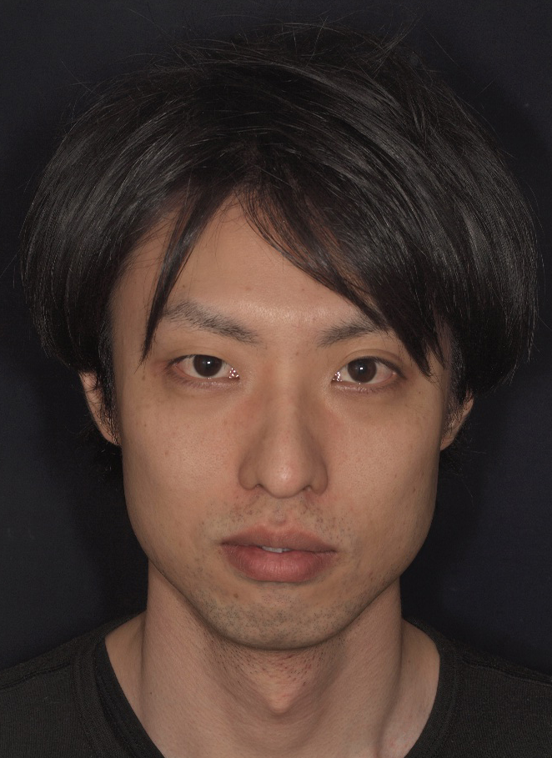
First visit
FV: 28th January 20014
Patient
L. D. (Age: 30)
Profession
Certified dental technician
Medical history
Healthy, smoker, allergic to spicy food
Dental history
Bruxism
Complaints
Impaired ability to masticate, sometimes pain (TMJ)
Wish
Gain a beautiful

Slide 3
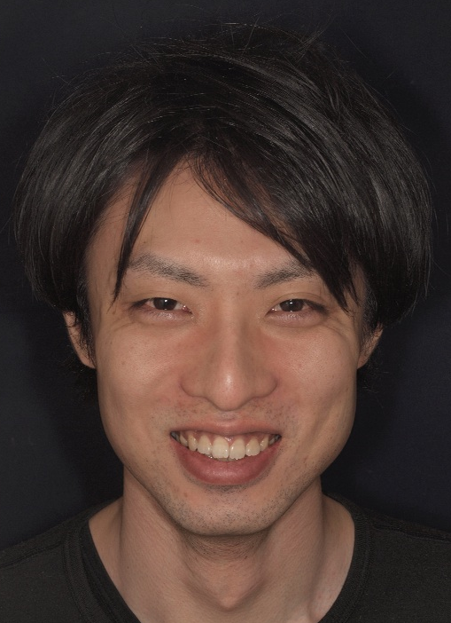
Dentofacial Findings
Midline
WNL
Left
Right
Inclined
Bipupillary line
Parallel
Slanted R
Slanted L
Incisal Edge Position
WNL
Long
Short
ILabial
Lingual
Smile Line/Occlusal Plane
WNL
Discrepancy
Rt.
Lt.
Arrangement and Form
WNL
Crowding
Spacting
Embrasure
Display
Low
Average
High
Color
WNL
Correction Planned
Notes:
Now, let’s move on to the clinical case.
The patient was 45 years old male.

Slide 4
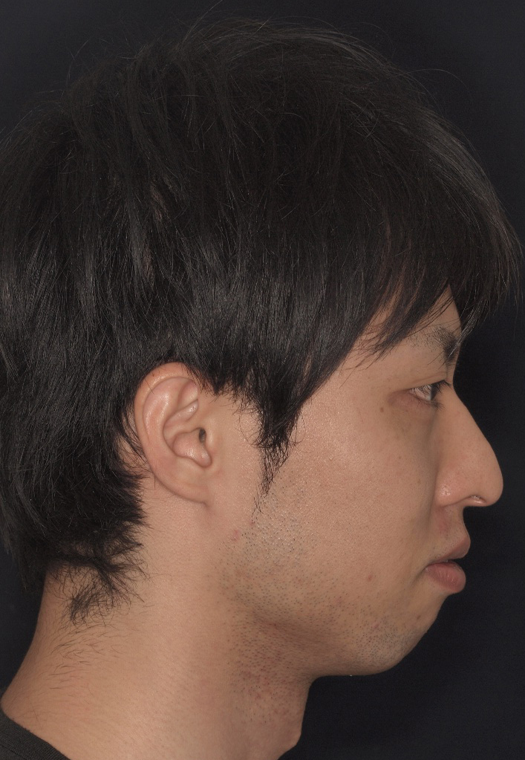
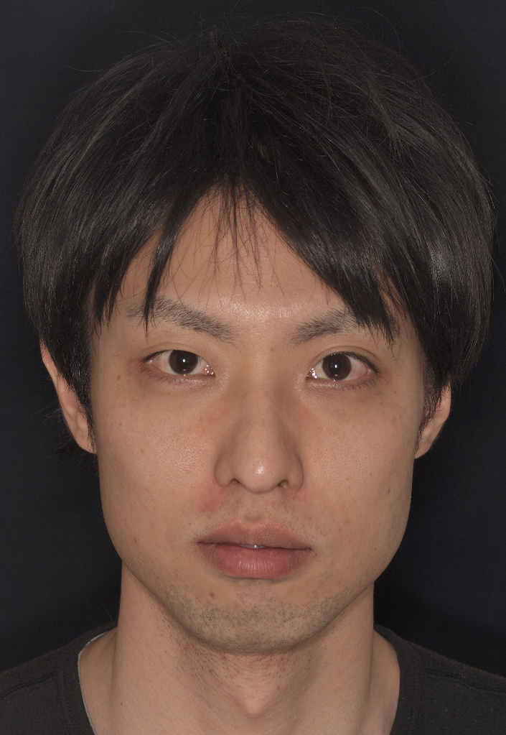
Extraoral Examination
Facial midline
Interpupillary line vs horizon
Profile
Normal
×
×
×
Convex
Concave
Centered
Deviated R
Deviated L
Parallel
Slanted R
Slanted L
E - line
Commissural line vs horizon
Lips
Thick
×
Parallel
Slanted R
×
Medium
Thin
Max 0mm
Mand -2mm
Slanted L

Slide 5
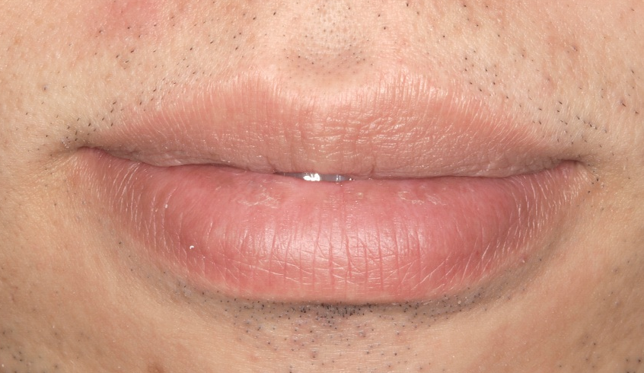
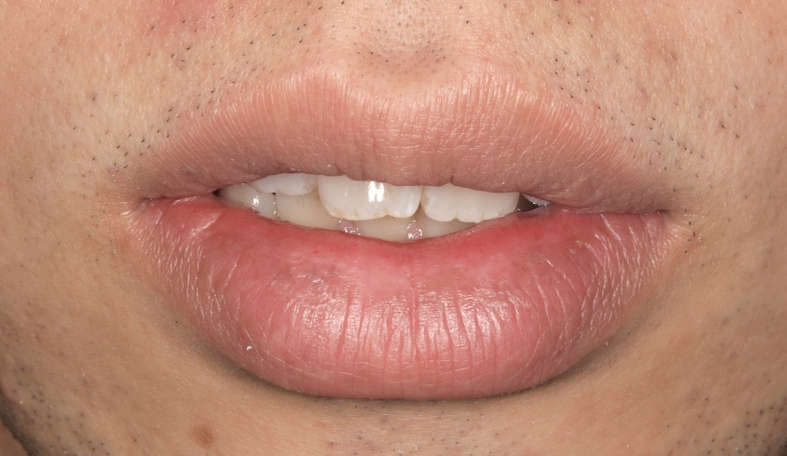
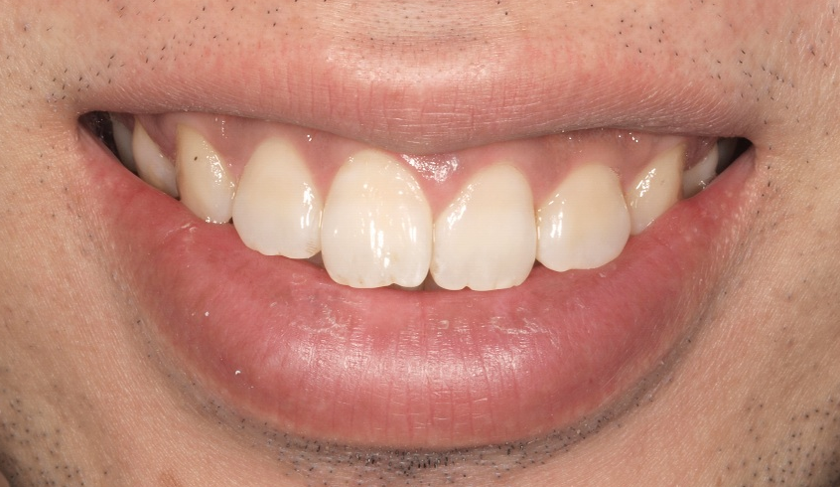
Extraoral Examination
Close
Rest
Smile

Slide 6
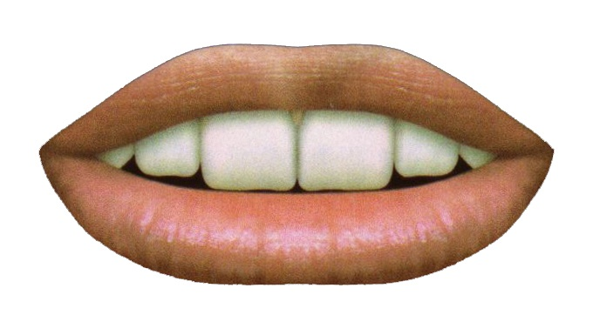
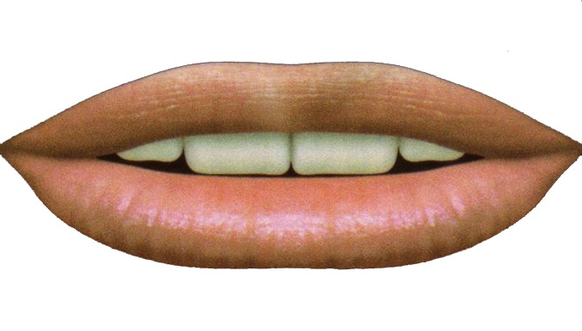
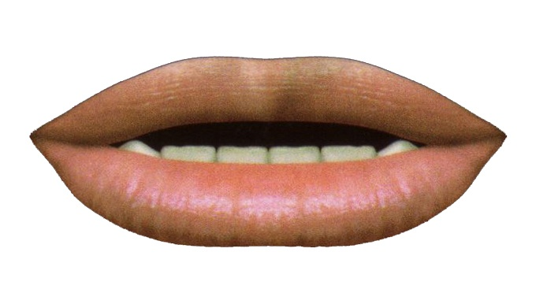
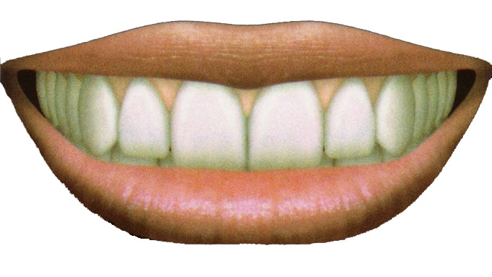
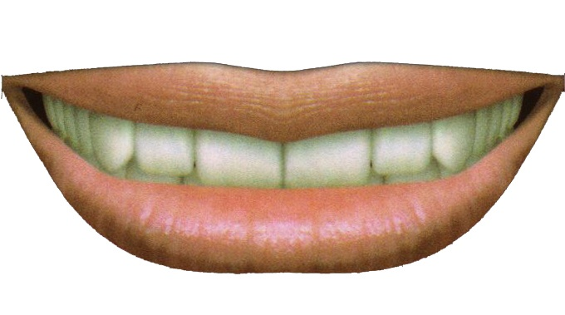
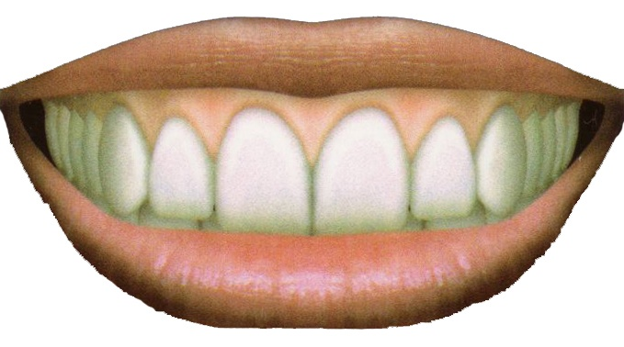
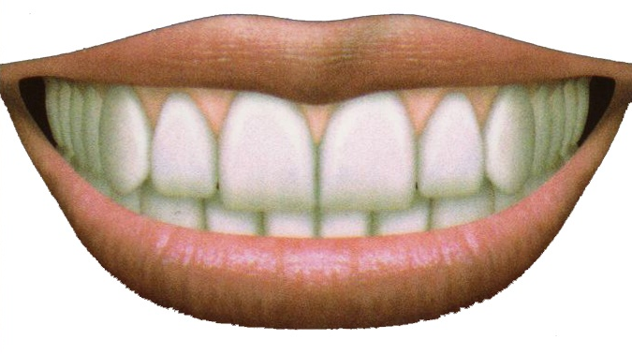
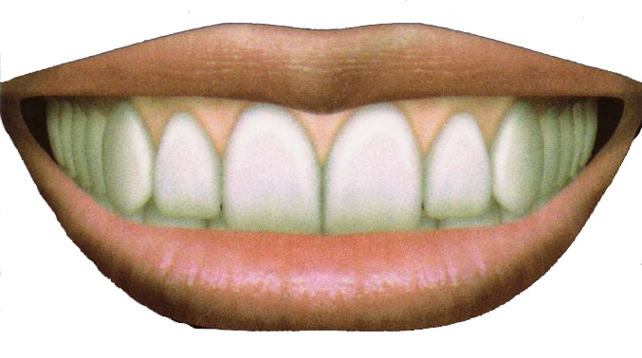
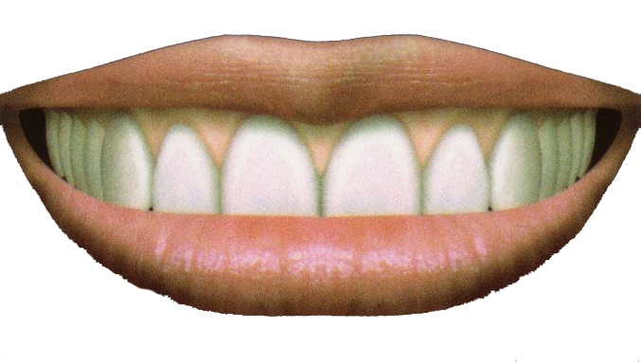
Esthetic Analysis - Dentolabial
Tooth exposure at rest
Smile line
Average
Low
High
Interincisal vs lower lip
Not
Contacting
Covering

Slide 7
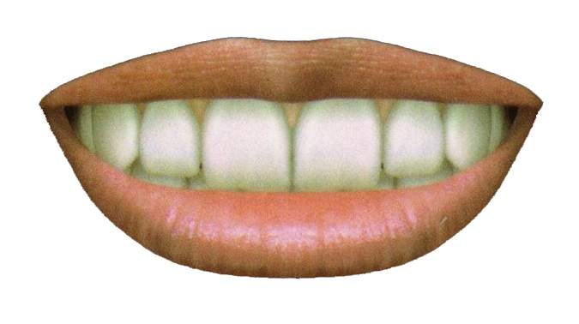
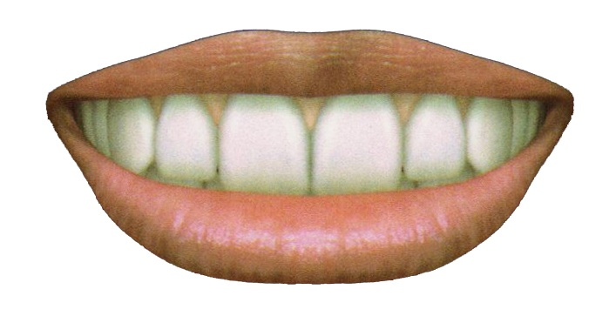
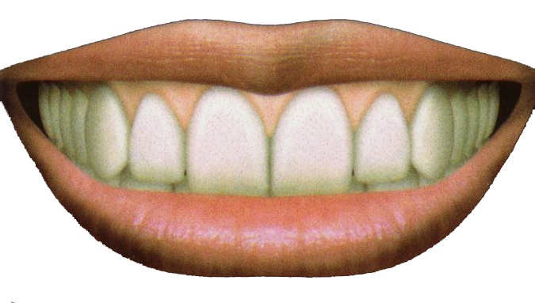
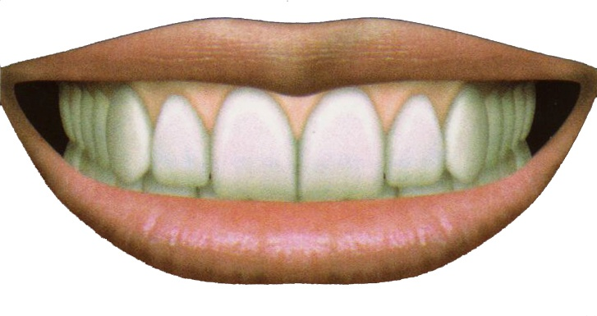
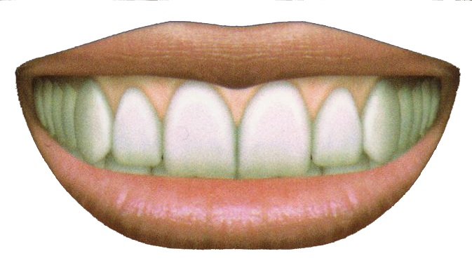
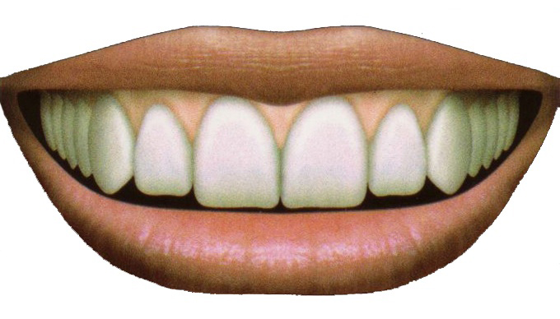
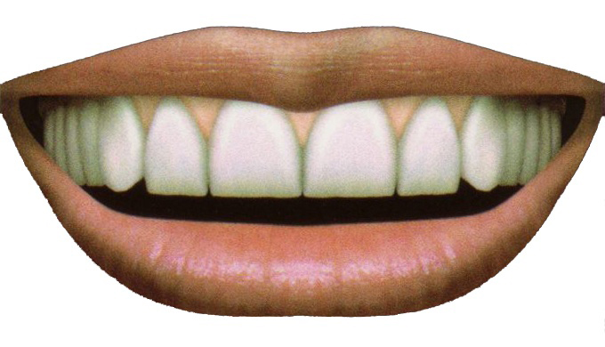
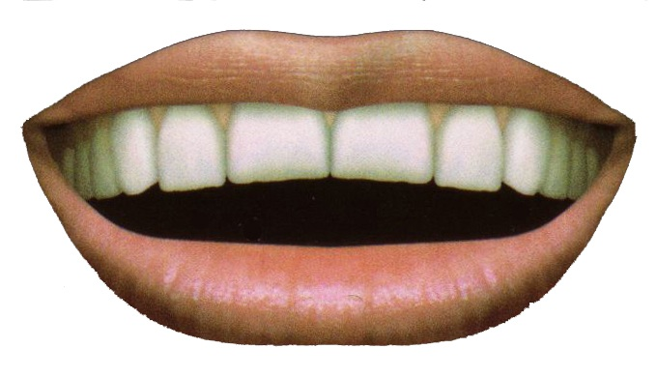
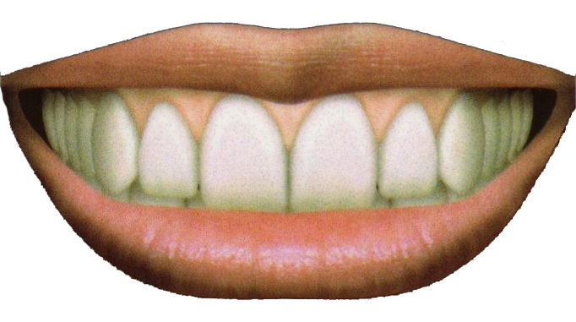
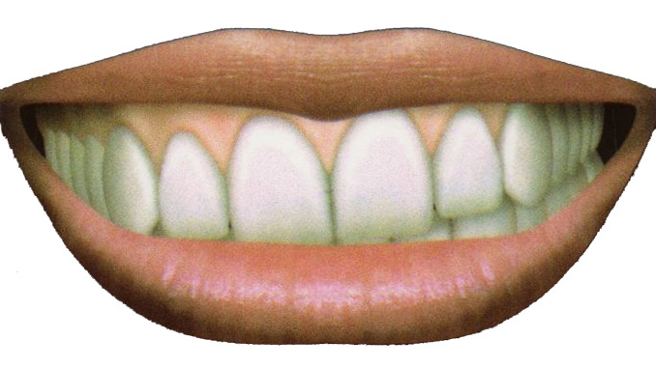
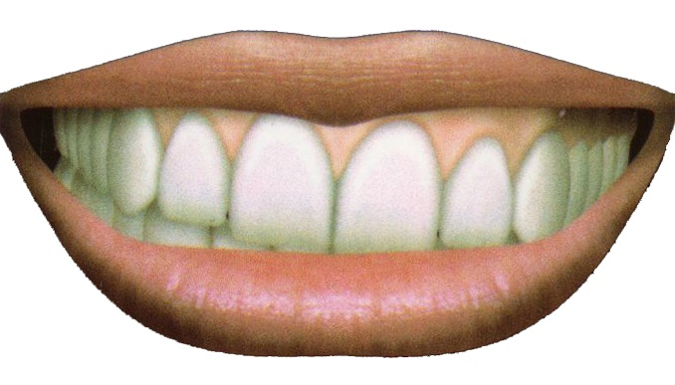
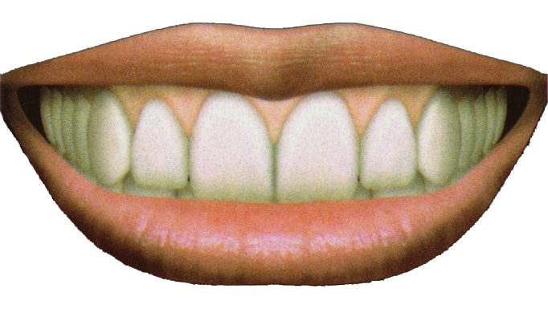
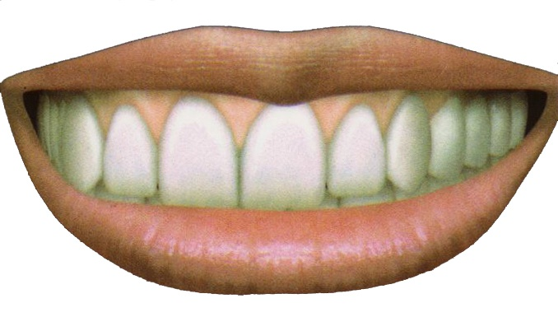
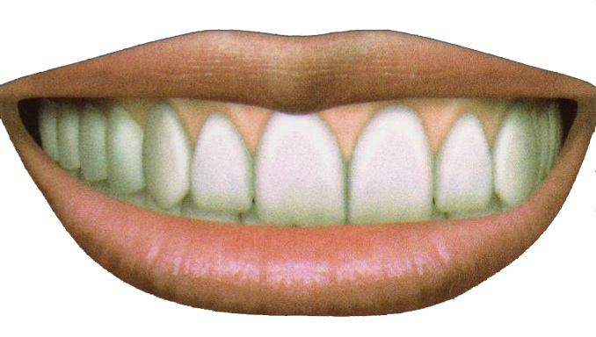
Esthetic Analysis - Dentolabial
6〜8
10
12〜14
Smile width
Normal
Wide
Absent
Buccal corridor
Convex
Flat
Reverse
Interincisal curve
Occlusal plane
vs.
commissural line
Parallel
Slanted R
Slanted L
Upper interincisal line vs. midline
Coincident
Deviated R
Deviated L

Slide 8
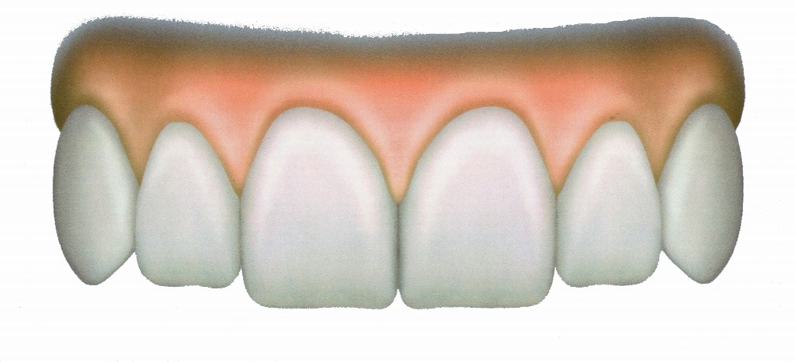
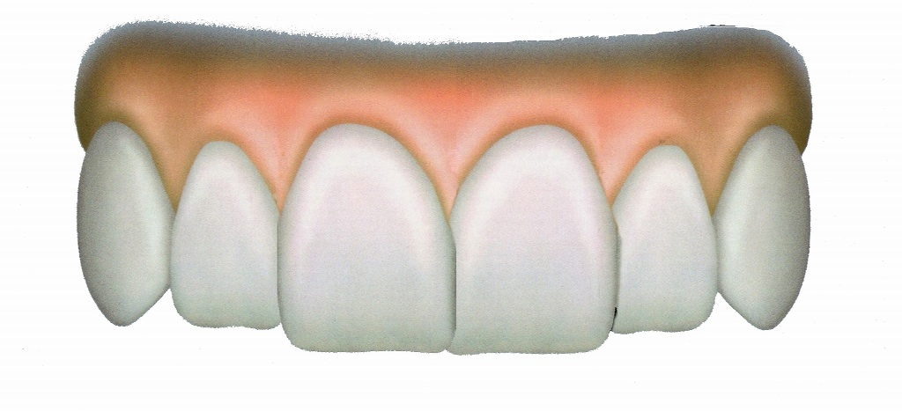
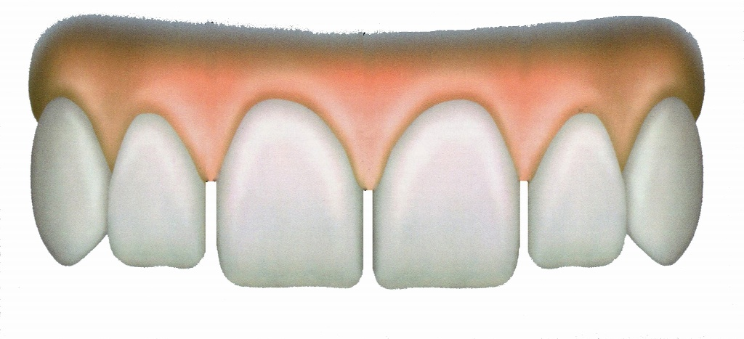
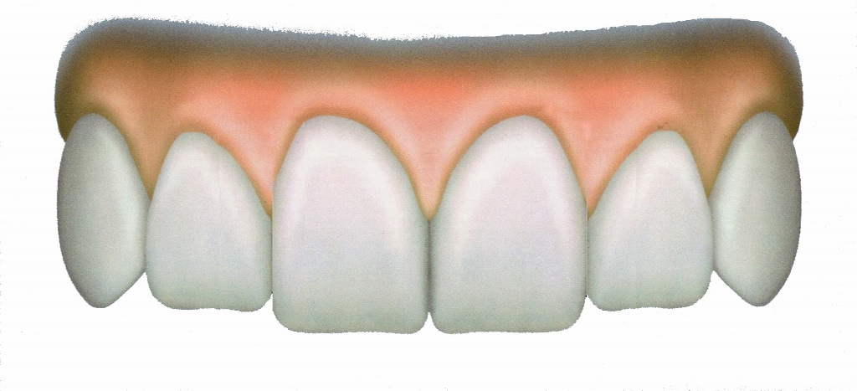
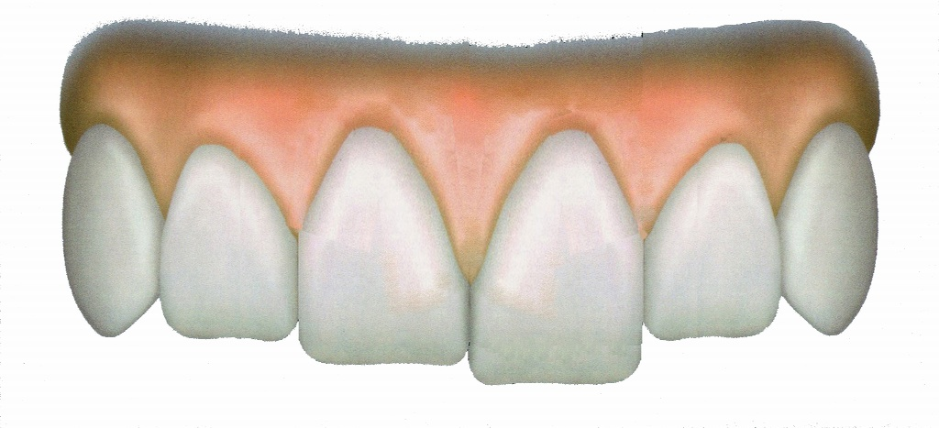
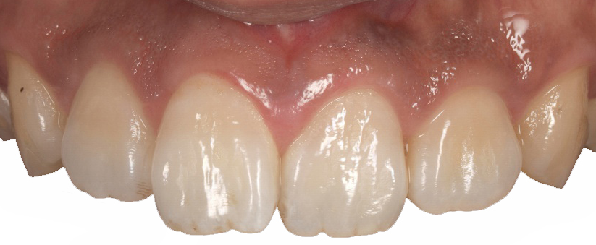
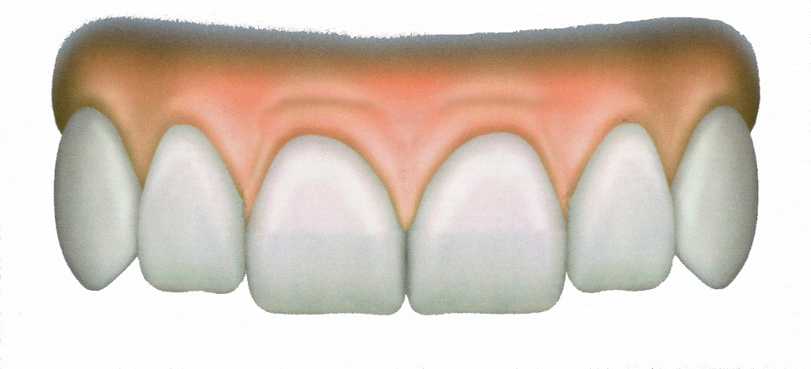
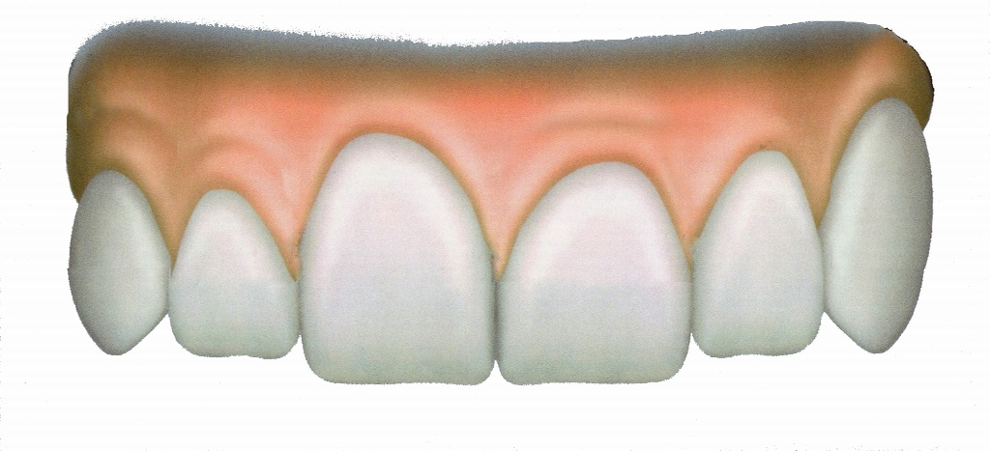
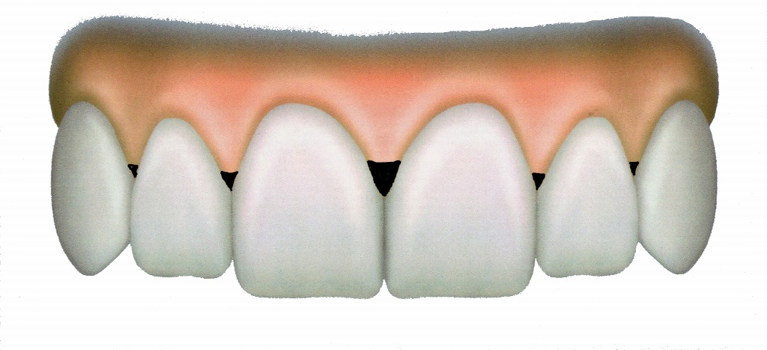
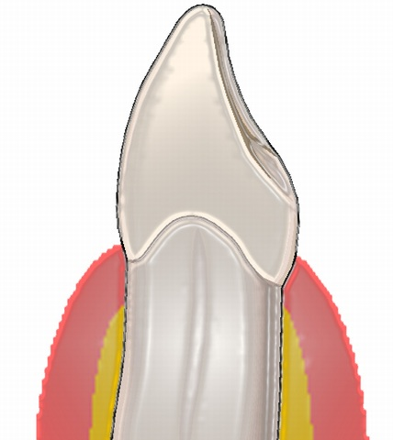
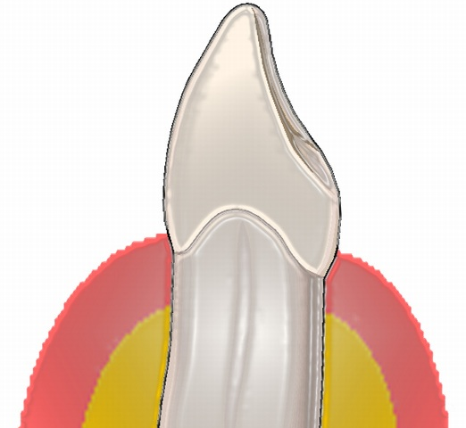
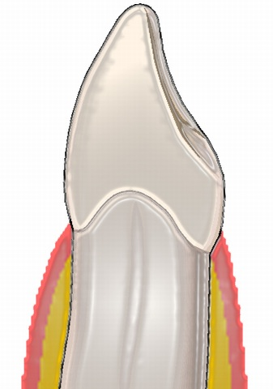
Esthetic Analysis - Dental & Gingival
Regular
Crowded
Diastema
Tooth
arrangement
Normal
Concerned
Abnormal
Tooth proportion
Symmetric
Concerned
Asymmetric
Gingival margins
Present
Absent
Papillae
ToothColor
WNL
Correction Planned
Moderate
Thick
Thin
Biotype

Slide 9
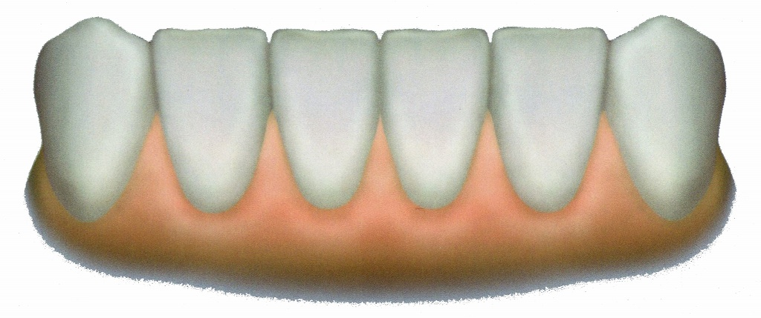
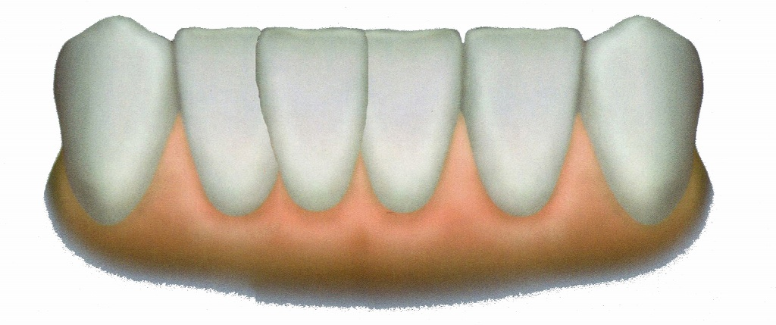
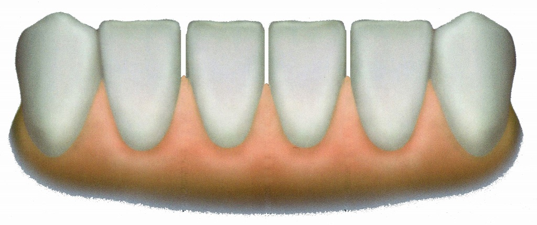
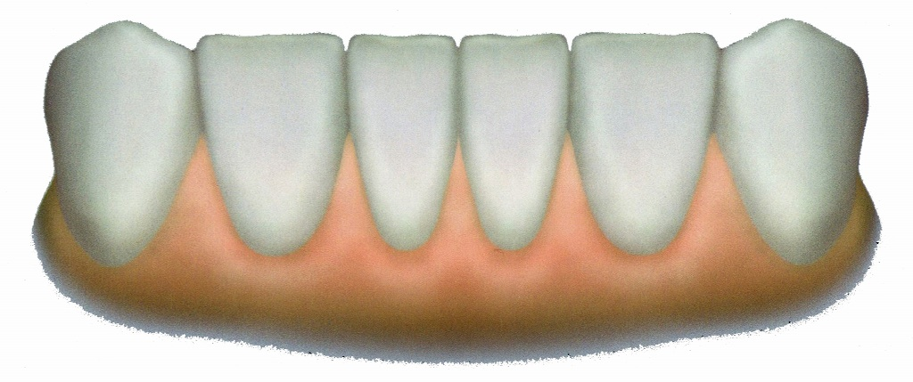
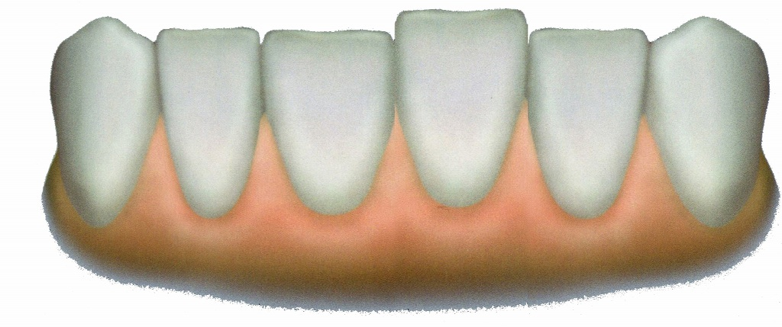
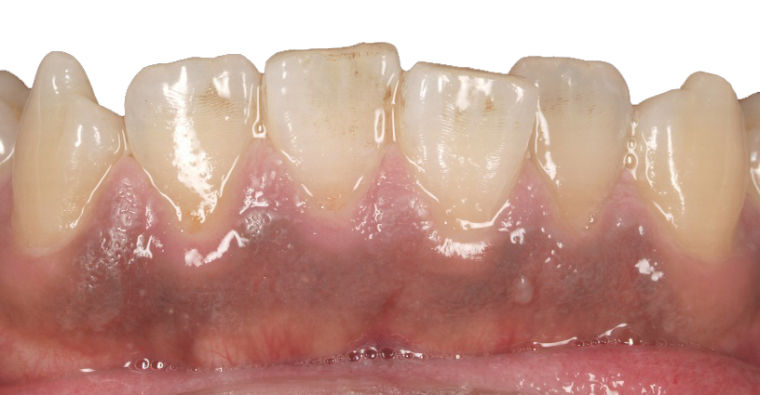
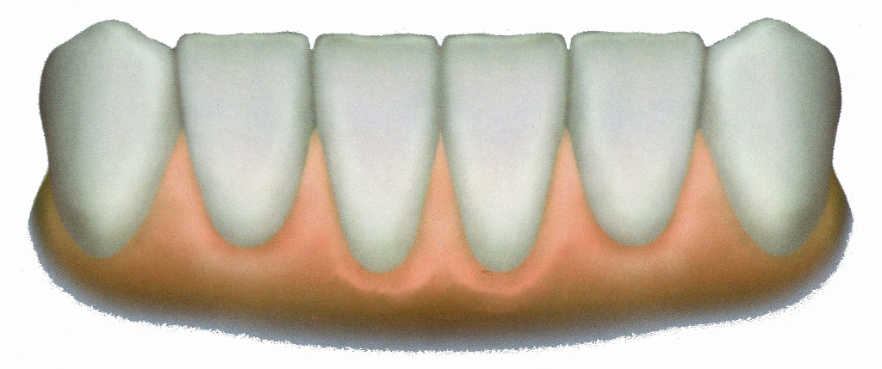
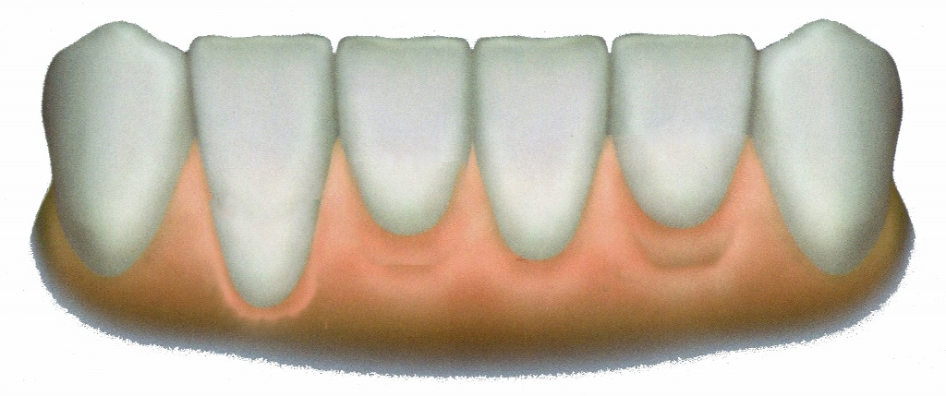
Esthetic Analysis - Dental & Gingival
Regular
Crowded
Diastema
Tooth
arrangement
Normal
Concerned
Abnormal
Tooth proportion
Symmetric
Concerned
Asymmetric
Gingival margins
Present
Absent
Papillae
ToothColor
WNL
Correction Planned
Moderate
Thick
Thin
Biotype

Slide 10
Functional Findings - Occlusion - Articulation
Palpation of joints
(1)Crepitus R : Open (early , late ) R : Close (early , late )
L : Open (early , late ) L : Close (early , late )
(2)Clicking R : Open (early , late ) R : Close (early , late )
L : Open (early , late ) L : Close (early , late )
(3)Sound of tapping R : Clear Double L : Clear Double
(4)Condyler pain R L
(5)Maximum opening 38mm
(6)Occlusal vertical dimension Open Closed Normal
Midline deviation
Midline deviation (C.R. to C.O.)

Slide 11
Functional Findings - Occlusion - Articulation
Palpation

Slide 12
First visit
Please set a treatment plan and describe your treatment strategy and sequence
Wish
Gain a beautiful

Slide 13
Diagnosis
Extraoral | Minor facial asymmetry
Intraoral | Torus mandibularis
Dental | Attrition, Impacted teeth
Periodontal | Plaque induced gingivitis
Guidance | Anterior teeth and Group guidance
Prosthetic | Multiple insufficient restorations
Radiographic | N.P.
Esthetics | Compromised esthetics

